Slide 1
Topic detection and Semantic analysis
Alp Yalcin 230888

Slide 2

Topic detection and semantic analysis
This project aims to make topic detection and semantic analysis of texts.
Texts with similar content have to be grouped together, whereas different texts have to be separated well from these compact groups.
Detecting emerging topics and describing these topics in compact clusters is also crucial for the task.
In order to reach all these goals, different techniques are combined. Ideas how to approach these questions and modeling process are explained briefly in this presentation.

Slide 3
Overview
Dataset explanation
Text embedding with Pre-trained sentence BERT model
Adding a semantic layer on top of the embeddings
Using embeddings for topic clustering and for detecting new topics
Adding new dataset into model
Wordnet and semantic analysis
Semantic relationships between words and identify clusters of related words

Slide 4
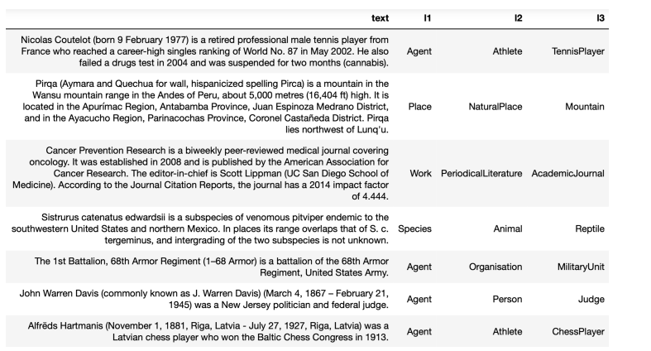
Dataset
Kaggle’s DBPEDIA textual dataset which was extracted from Wikipedia is used for analysis.
DBPEDIA dataset includes 3 taxonomic hierarchical categories with 9,70, 219 classes and text variable for 342,782 Wikipedia articles.

Slide 5
Dataset
3 Category levels give an overview about the topics of the texts. Higher levels give more specific information about the text.
Provided DBPEDIA is already separated into train, validation and test datasets with 240942, 36003, 60794 observations, respectively.
As an initial steps, first category (level 1) is investigated more to see the bigger picture of the dataset.
Level 1 has 9 classes with names Agent, Work, Place, SportsSeasons, Species, TopicalConcept, Event, UnitOfWork and Device

Slide 6
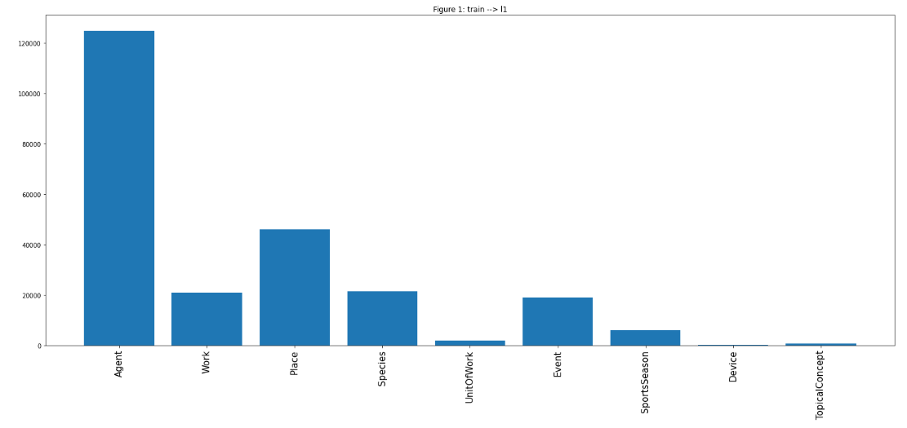
Dataset
The number of texts in each labels for category 1 in training dataset is quite imbalanced and this issue may be a reason to have biased results on models.
Agent class include 124,798 observations whereas Device only has 248 texts in training dataset.

Slide 7
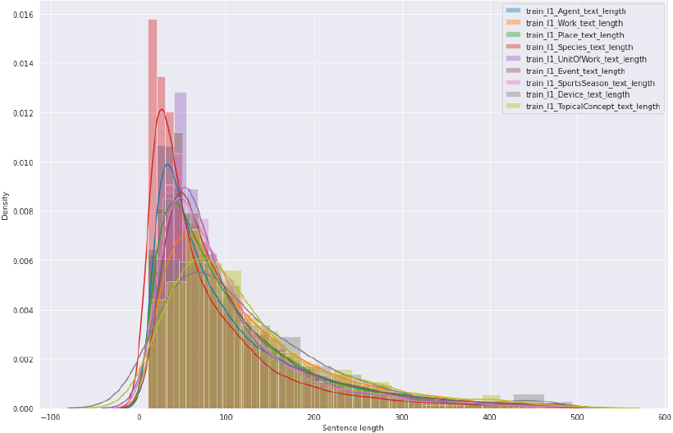
Dataset
Distribution of text lengths for each classes can be observed from text variable in the dataset. As it showed in the figure, text lengths for each labels are different.
%95 of all texts lengths is 298 tokens which can be selected as fixed number in preprocessing part to handle this issue ( truncating longer sentences to 298 tokens and padding shorter sentences to the same value)

Slide 8
Data Modelling
In order to detect connections between texts and extract various topics, BERTopic architecture is taken as a reference for modeling.
Data modelling architecture :
Text embedding with Pre-trained sentence BERT model.
In order to improve the embedding quality, supervised neural network model is used. 768-dimensional vector text embeddings from previous step is taken as an input, “batch normalization” layer of supervised model is taken as a new embedding layer for the next step.
After supervised modelling, 28- dimensional vector layer of model is taken as a new input for clustering model.
KMeans and HDBSCAN unsupervised methods are used for clustering model.
PCA is implemented on 28- dimensional vector layer and decrease that vector to 2 dimensional embeddings for the purpose of make visualization of clustering performance.

Slide 9
Data Modelling - Text embedding with Pre-trained sentence BERT model
Generating topic aware embeddings for texts is crucial for the modeling part for topic detection task. Texts have to be converted into vectors.
Sentence Transformers framework is used to compute text embeddings which is based on Transformer network architecture .
Pre-trained sentence BERT model called “paraphrase-mpnet-base-v2” from Sentence Transformers framework is used for text encoding process.
This model provides a 768-dimensional vector for each text in the dataset.

Slide 10
Data Modelling - Text embedding with Pre-trained sentence BERT model
“paraphrase-mpnet-base-v2” is trained on a large corpus of text data with masked language modelling objective and a next sentence prediction objective.
Masked language modelling objective involves masking some tokens in the input text and training the model to predict those masked tokens based on the context provided by other tokens in the input. Model can learn contextual representations of the words and phrases with the help of this task
Next sentence prediction objective involves providing the model with pairs of sentences and training it to predict whether the second sentence follows the first sentence in the original text or not. This helps the model learn relationships between sentences and context in which they occur.
This objectives aim to improve the quality of the learned representations which can be used for semantic analysis and topic detection tasks.

Slide 11
Data Modelling – BERT
BERT (BiDirectional Encoder Representation from Transformers) model is used to generate sentence embeddings. It uses encoder architecture from the transformer model in bidirectional training technique .
Bidirectional training reads the entire sequence of words at once as opposed to directional models, which reads the text input sequentially. This characteristic allows the model to learn the context of a word based on all of its surroundings (left and right of the word).

Slide 12
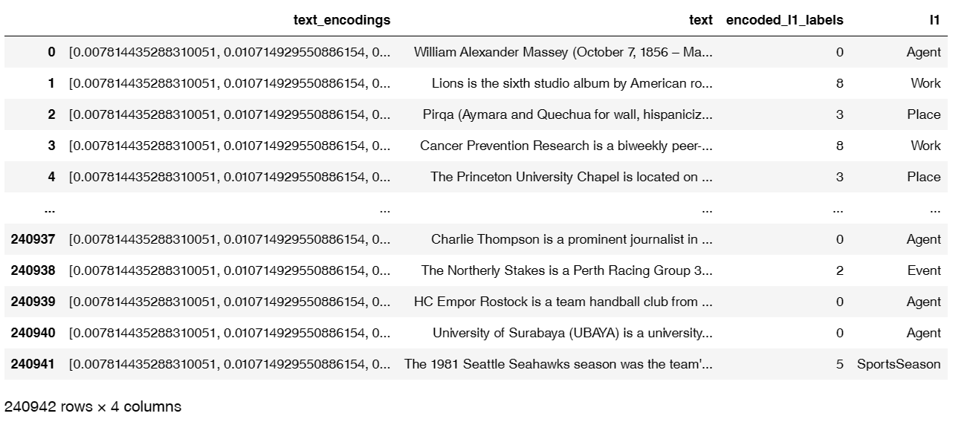
Data Modelling - Text embedding with Pre-trained sentence BERT model.

Slide 13
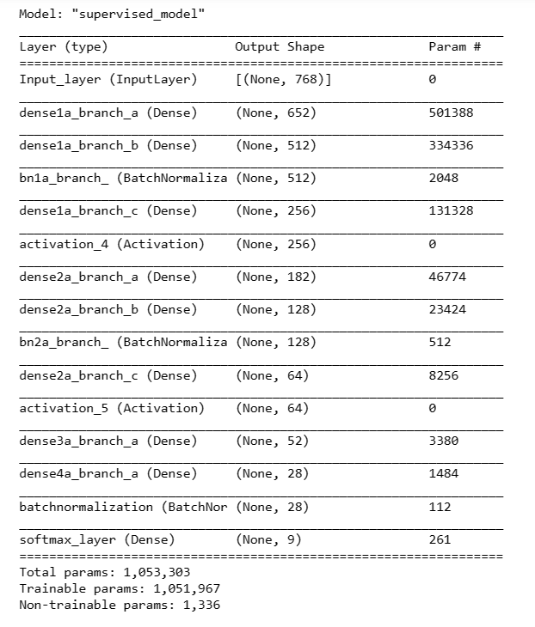
Data Modelling - Supervised neural network model to improve embeddings
Supervised model is used to improve the embedding quality of the predictions and decrease the dimensionality of the embeddings.
Batch normalization layer is taken as a new embeddings. After this process, text embeddings shape become 28 dimensional from 768 dimensions.
Predictions of supervised learning is not taken into account, prediction of the model will be done via unsupervised learning in next step of the architecture.

Slide 14
Data Modelling – Clustering Algorithms
After training the embeddings with supervised neural networks algorithm, Kmeans and HDBSCAN clustering algorithms are used for prediction of 28 – dimensional text embeddings.
PCA and TSNE methods are used for dimensionality reduction to visualize the clusters into 2-dimensional and 3-dimensional shape.

Slide 15
Data Modelling – Clustering Algorithms
After applying the algorithms, it is important to check the cluster quality and its consistency.
Silhouette score is used to determine the quality of the clusters. Silhouette score takes Inter-cluster and Intra-cluster variances into consideration and gives the value between -1 and +1. -1 represents the worst cluster quality and +1 represents the best cluster quality.
Intra-cluster is a variance of data points within a particular cluster whereas Inter-cluster is variance of cluster centers.
Inter-cluster variance should be higher and intra-cluster variance should be lower in order to get well separated clusters.

Slide 16
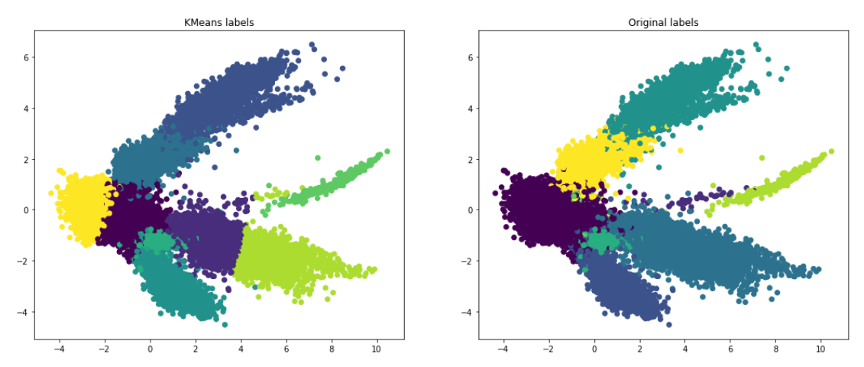
Data Modelling – KMeans
Silhouette score for predicted labels with KMeans: 0.48206675
Silhouette score for original labels: 0.68111986

Slide 17
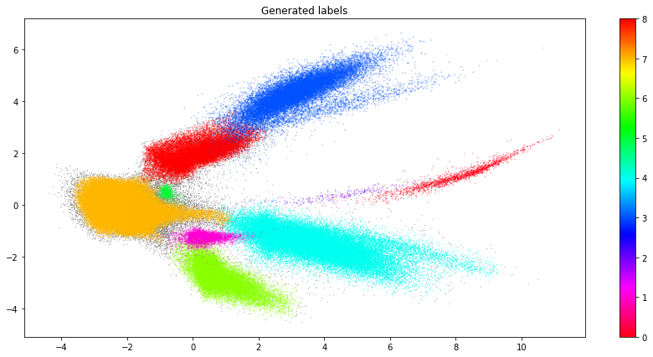
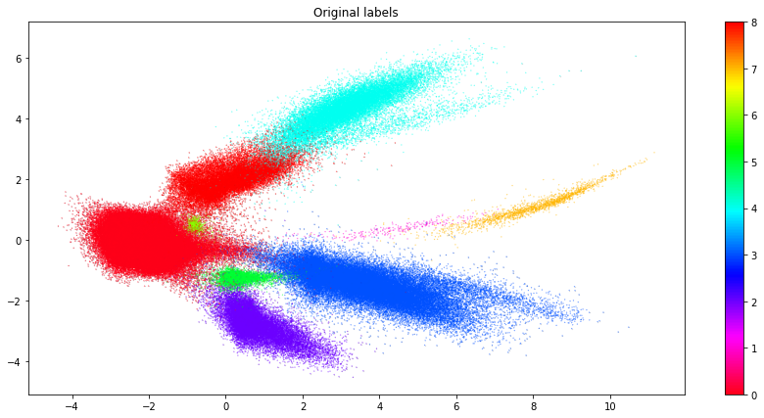
Data Modelling – HDBSCAN
Silhouette score for predicted labels with HDBSCAN: 0.59938186
Silhouette score for original labels: 0.68111986

Slide 18
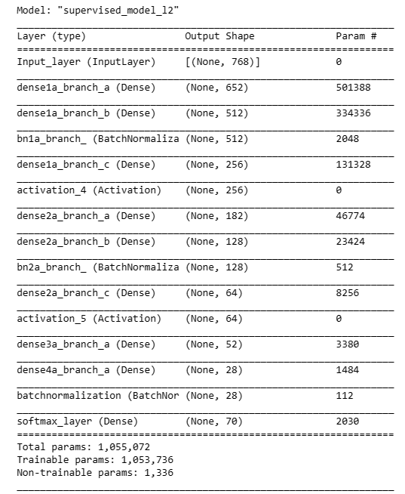
Data Modeling – KMeans – Category II
Same model architecture is also used for category 2 labels with 70 classes.
Supervised embedding training is used before clustering models.
TSNE dimensionality reduction method is used for category 2 classes instead of PCA method.

Slide 19
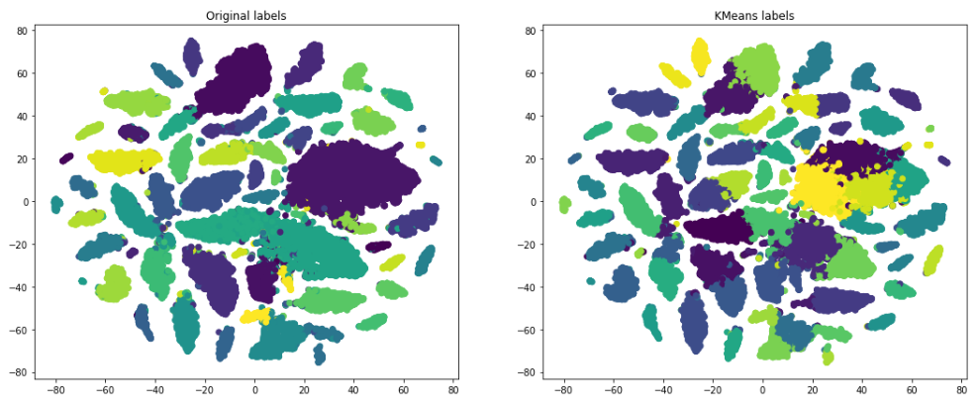
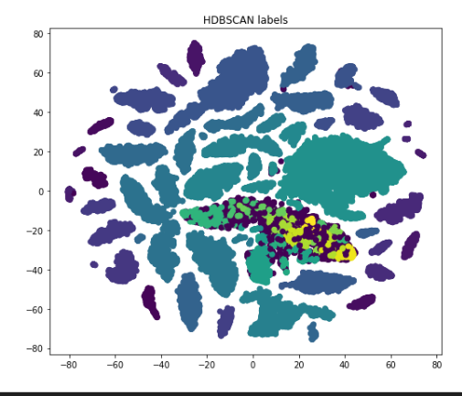
Data Modelling for Category II
As it can be seen from the figures of clustering methods which is used for category 2 classes, both Kmeans and DBSCAN algorithms still can separate the texts well.
Silhouette score for original labels: 0.45758322
Silhouette score for predicted labels with HDBSCAN: 0.3294771
Silhouette score for predicted labels with KMeans: 0.4242713

Slide 20
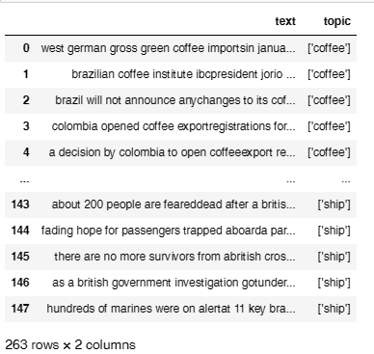
Adding new dataset into model
Question : How the clustering model works when we add new observations with 2 different classes into dataset ?
In order to test how well our clustering separation works with unseen topic observations, 263 new observations are added to DBPEDIA dataset.
New observations are taken from “Reuters-21578 Text Categorization Collection Data Set”. These observations are collected from the Reuters financial newswire service in 1987.
115 of 263 observations belong to label “coffee” topic class, and 148 observations belong to “ship” topic class.

Slide 21
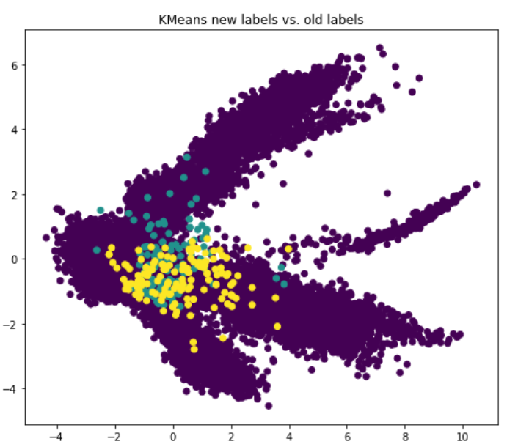
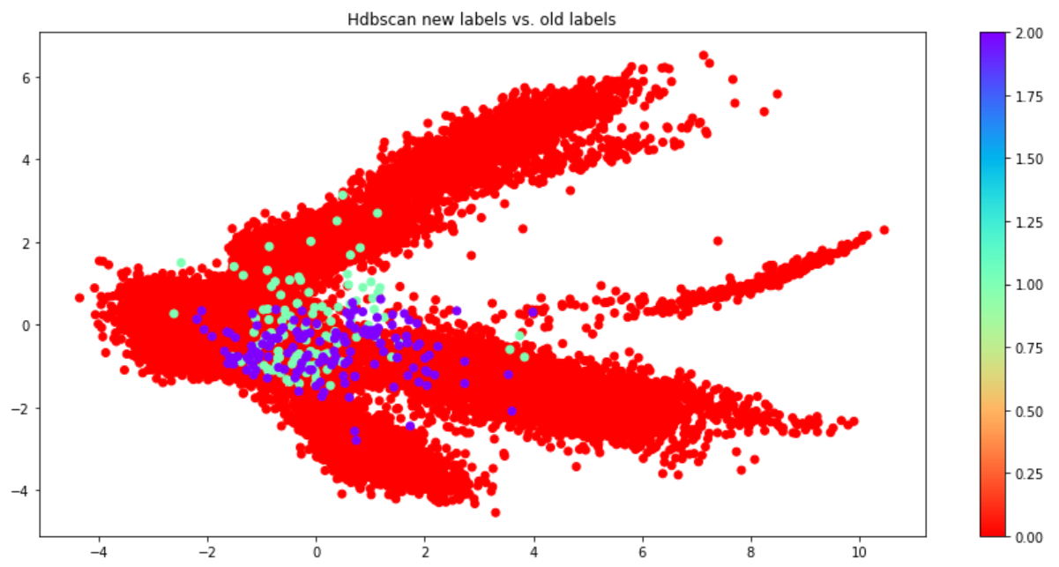
Adding new dataset into model
Same Sentence Transformers pretrained embedding model and neural networks supervised algorithm is used for new observations.
These 263 observations are added to dataset and Kmeans and HDBSCAN clustering algorithms are again used for new dataset.

Slide 22
Adding new dataset into model
Question: 2 new topics is not separated well on the current clustering model. These two clusters are also intertwine each other and they tend to be a part of existing labels. What can be the reason of this issue ?
Hypothesis: In category 1 classes, model only has 9 clusters, therefore our new topics can already be a member of existing cluster or clusters.

Slide 23
Adding new dataset into model
As an intuitive answer,
New labels are "coffee" and "ship“ : coffee texts are generally related with coffee organizations decisions, country policies on coffee business or sales/stock situation of coffee business. This looks these texts are related with Place" or "Agent“ l1 topics. "Coffee" topic is generally located close to "Agent" cluster, which includes Person, Politician, Company, Organization, Educational Institution subgroups.
Coffee observations are also located close to "Place" cluster, which includes Route Of Transportation, Natural Place, Infrastructure, Settlement subgroups.
"Ship" topic is related again with topics such as locations, working conditions, political situations.
Therefore, coffee and ship topics are quite close to subgroups of category 1 classes and it looks like both topics are belong more than only one class .

Slide 24
WordNet
In order to find text similarities, semantic analysis and detect the best topic separations, unique semantic network which is called WordNet is used as a next step.
WordNet is a lexical database for the English language, which was created by Princeton, and is part of the NLTK corpus.
Wordnet provides a structured and comprehensive way of organizing words based on their meanings.
Wordnet groups words into set of synonyms called “synset”, where each synset represents a distinct concept.
Synsets are connected to each other through a network of semantic relationships such as hypernyms,hyponyms, antonyms, and holonyms
DBPEDIA textual dataset words is analyzed and category 1 classes are examined in detail.

Slide 25
WordNet - Preprocessing
Python’s The Natural Language Toolkit (NLTK) library is used for statistical language processing and analyzing the DBPEDIA dataset.
Relationship of words within the category classes and between category classes are examined. (l1 category with 9 classes)
Words are tokenized
Regular expression operation is used to clean punctuations of texts.
Stopwords are removed from the dataset in order to have significant words for data analysis.
Lemmatization is used to group together of different forms of the same words.
The most frequent words for each class are considered for further analysis.

Slide 26
WordNet - Hypernyms
Hypernyms for all words in each classes are calculated as follows;
All synonymous words for each words of the class are found.
Hypernyms of each words and its synonymous words in the class are obtained.
After finding hypernyms of each words and synonyms, 50 most frequent hypernyms are determined and saved as level 1 hypernyms for that specific class.
Then, hypernyms of these 50 most common hypernyms (level 1 hypernyms) are calculated again. These hypernym words are saved as level 2 most frequent hypernyms for that specific class.
Step 3 is repeated for level 2 hypernym words and noted as level 3 most frequent hypernyms.

Slide 27
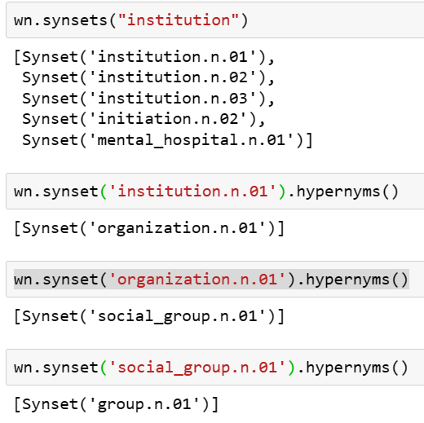
WordNet – Hypernyms
All synonymous words for “institution” word are found
Level 1 hypernym for institution.n.01 word
Level 2 hypernym
Level 3 hypernym

Slide 28
WordNet - Hypernyms – Path similarity
After calculating most frequent hypernyms for 3 levels, pairwise word similarity scores between the words are calculated for most common words and most common 3 level hypernyms of these words.
Path similarity is used to calculate similarity scores between words. It denotes how similar two words senses are, based on the shortest path that connects the senses in the (hypernym/hyponym) taxonomy. The score is in the range 0 to 1.
Hypernyms with high path similarity scores within the class are calculated.
Hypernym graphs for different classes are visualized with GraphX library.

Slide 29
WordNet – Hypernyms Graphs
In the next slides word level 1 hypernyms word representations and connection graphs are shown for 3 classes. (Agent, Location, Place)
Words with highest pairwise path similarity scores within the class are colored in the same colors. Other words are colored in dark green.
For instance, in Agent hypernyms, “organization” and “association” words have high pairwise path similarity score, they both colored with blue. Also, “group” and “people” words has high similarity score and they both colored with pink. Words pairs with average scores are all colored with dark green color.
Interesting subgroups for the particular graphs are circled and noted for further analysis. For instance, “event” class has “time” and “location” subgroups which makes sense to have these subgroups in event topic.

Slide 30
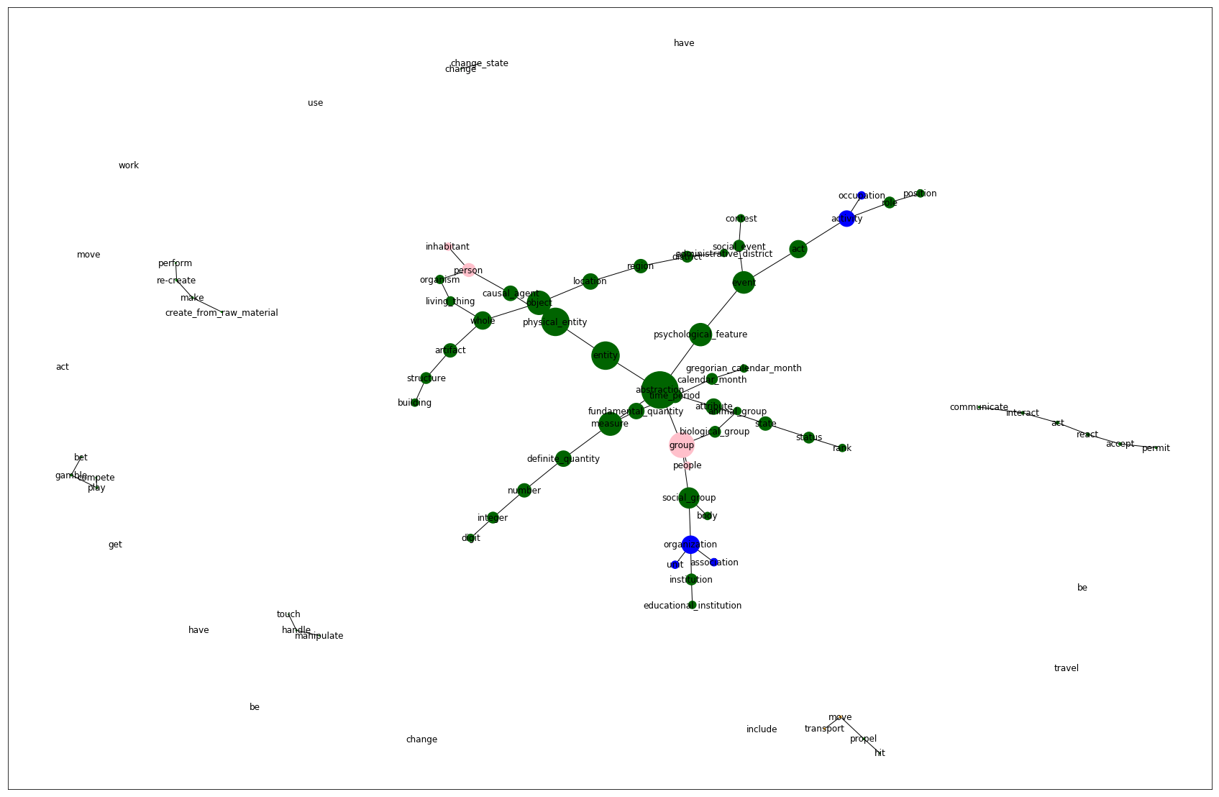
WordNet – Agent class hypernyms
Living organism
Subgroup
creativity
subgroup
compete
subgroup
Action subgroup
Organization subgroup

Slide 31
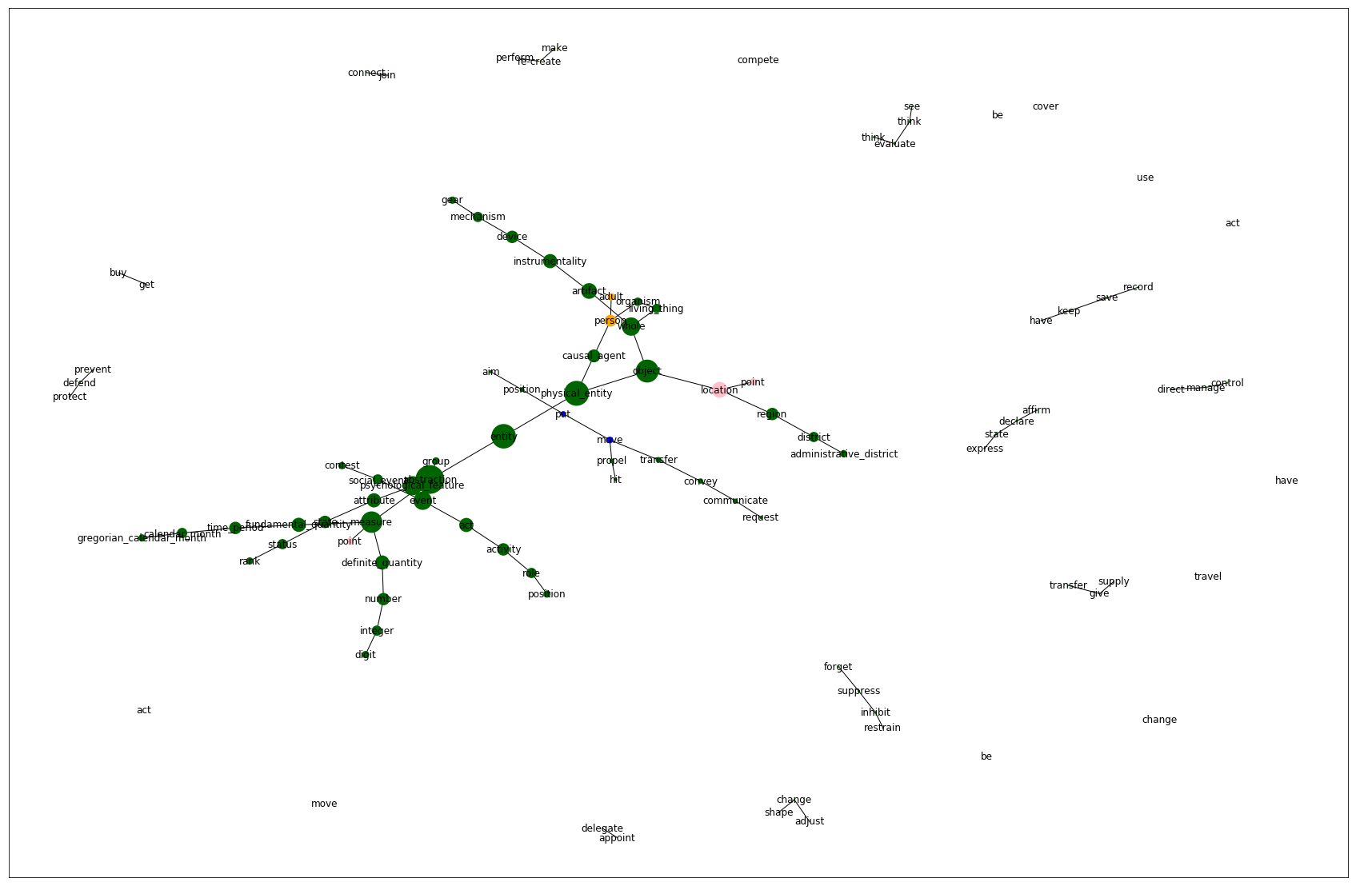
WordNet – Event class hypernyms
Location subgroup
Creativity
subgroup
Time subgroup

Slide 32
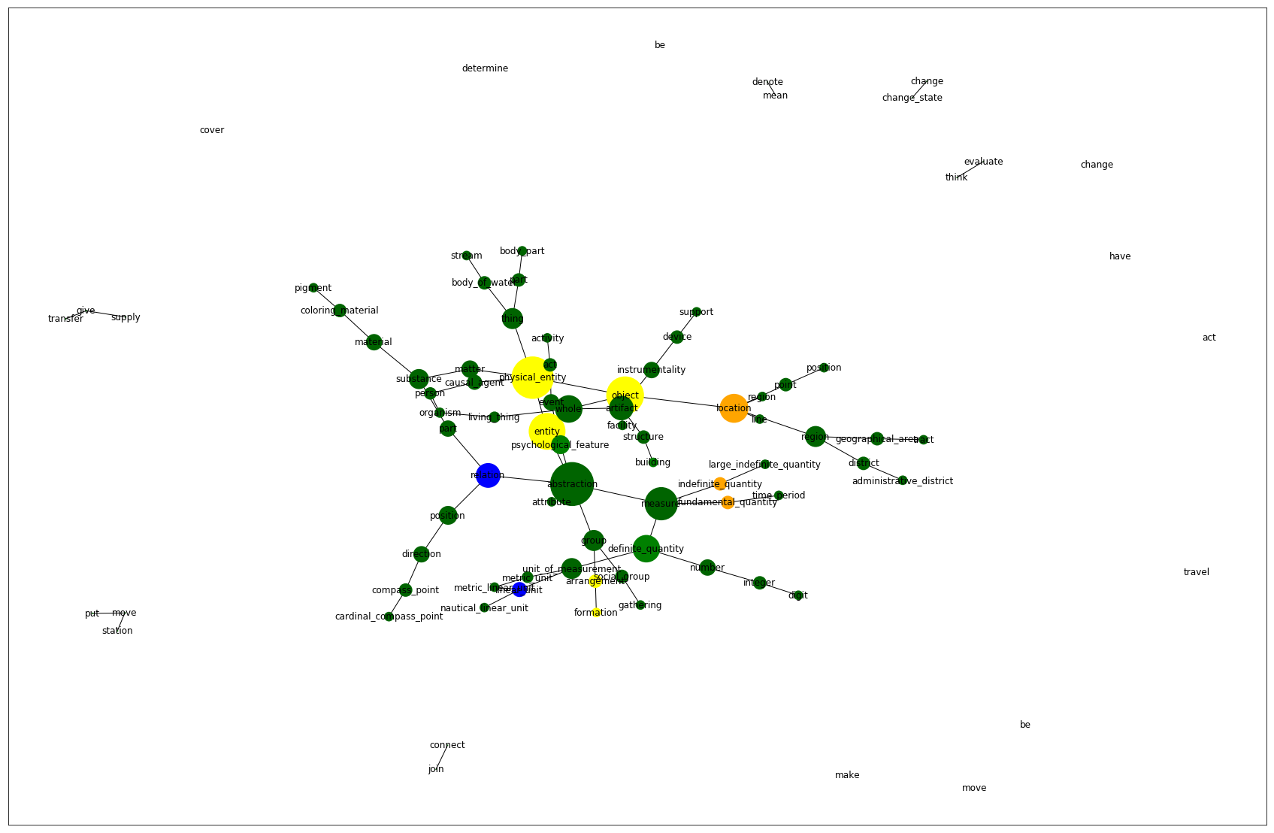
WordNet – Place class hypernyms
Bridge/river / canal / lake
Natural places
Structure subgroup
Region / Location subgroup
Direction /Compass
Navigating subgroup

Slide 33
Outlook
After visualization of semantic analysis graph which shows the relationship of words to the order of hypernym hierarchy, it is obvious that some subgroup connections emerged within classes as it shown in the previous graphs.
Next, this information gathered from semantic analysis can be condensed and more compact descriptions can be made.
Connections, similarities and distinctive dissimilarities between different classes can be analysed for better clustering and detection of emerging topics.

